Slide 1


Federated Multi-Task Learning
Virginia Smith, Chao-Kai Chiang, Maziar Sanjabi, Ameet Talwalkar
31° Conference on Neural Information Processing Systems (NIPS 2017)
Riccardo Zaccone s269240@studenti.polito.it
MLDL A.A 2020/2021

Slide 2
How to use this presentation
Mainly as presentation aid, but enriched with other resources to be used as learning tool;
GitHub repository:
A copy of the original paper, with my notes;
The .pptx and .pdf file of the presentation submitted for the course and used to explain the paper to the class;
The .mp4 of the final paper presentation video submitted for evaluation;
Cited papers, with notes and references;

Slide 3
Outline
Introduction
The federated scenario
What this paper is about
Related work
Federated Multi-Task Learning
Theory;
Experiments;
Conclusion

Slide 4
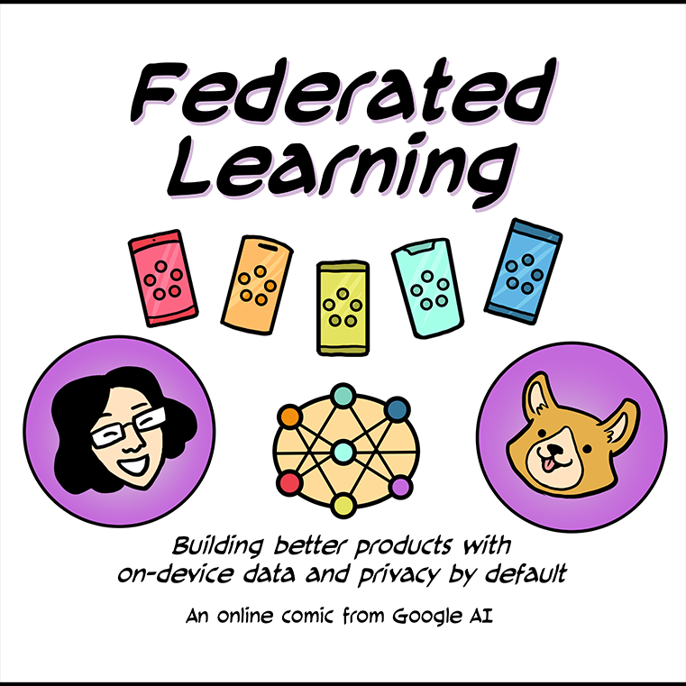
Introduction
The Federated Scenario
What this paper is about
Image taken from: https://federated.withgoogle.com/

Slide 5
The Federated Scenario
Def:
“Federated learning is a machine learning setting where multiple entities (clients) collaborate in solving a machine learning problem, under the coordination of a central server or service provider. Each client’s raw data is stored locally and not exchanged or transferred; instead, focused updates intended for immediate aggregation are used to achieve the learning objective”
Key points:
Entities involved are heterogeneous, and they cannot be controlled by the server: it is «federated», not «distributed»!
Entities can have data with different underlying distribution (IIDness);
Privacy is paramount.

Slide 6
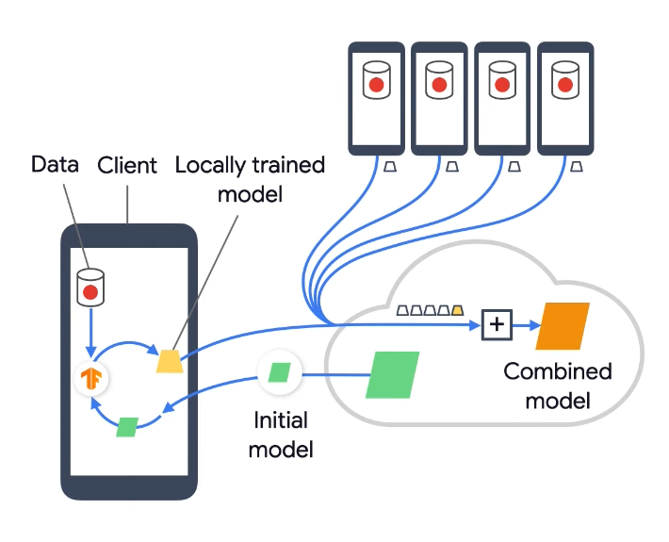
The Federated Scenario
System challenges:
High communication cost;
Dealing with stragglers;
Robustness to faulty clients (or network problems);
Statistical challenges:
Non-IDDness of local datasets (global model scenario);
Capturing the relationships among nodes and their associated distribution (multi-task scenario).

Slide 7
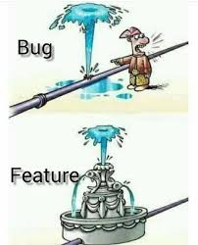
What this paper is about
Is learning a single global model the best possible?
Non IID-ness could be itself information to be learnt, a.k.a similar devices can have similar data distributions;

Slide 8
Related Work
Distributed Multi-Task Learning:
[1, 35, 54, 55]: the proposed methods do not allow for flexibility of communication versus computation;
[23] and [7] allow for asynchronous updates to help mitigate stragglers, but do not address fault tolerance;
[30] does not explore the federated setting (assumption that the same amount of work is done locally on each);

Slide 9
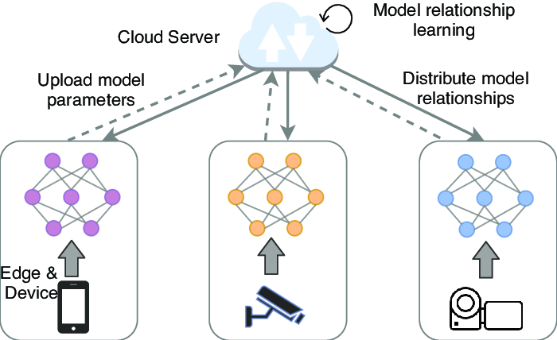
Federated Multi-Task Learning
General MTL setup
MOCHA
Discussion on assumptions
Image taken from: https://www.researchgate.net

Slide 10
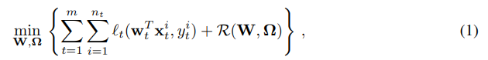
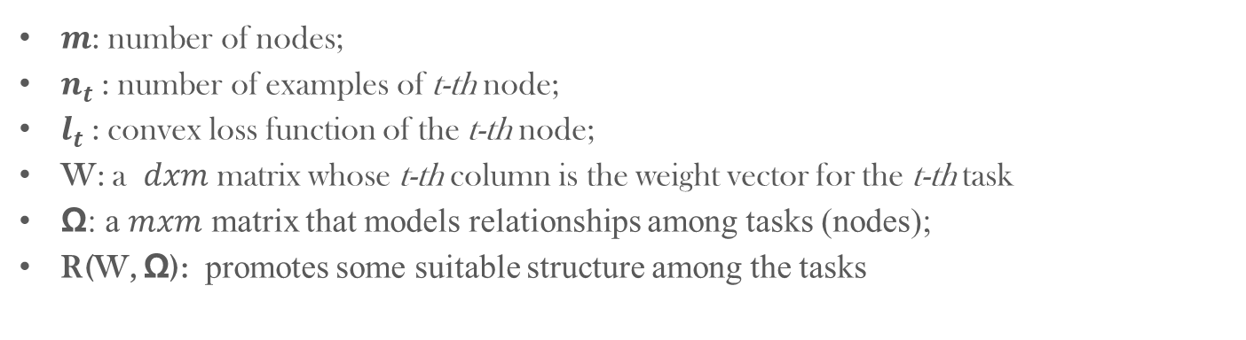
General MTL setup
$m$: number of nodes;
$n_{t}$: number of examples of t-th node;
$l_{t}$: convex loss function of the t-th node;
W: a $dxm$ matrix whose t-th column is the weight vector for the t-th task
Ω: a $mxm$ matrix that models relationships among tasks (nodes);
R(W, Ω): promotes some suitable structure among the tasks

Slide 11
General MTL setup - observations
When fixing Ω, updating W depends on both the data X, which is distributed across the nodes, and the structure Ω, which is known centrally;
When fixing W, optimizing for Ω only depends on W and not on the data X.
=>solving for Ω is not dependent on data, can be computed centrally, so the method focuses on techniques for updating W;

Slide 12
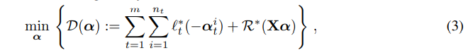

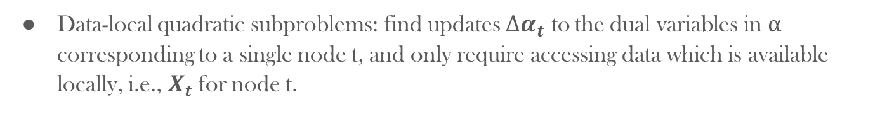
MOCHA
Dual problem formulation:
Data-local quadratic subproblems: find updates $∆α_{t}$ to the dual variables in α corresponding to a single node t, and only require accessing data which is available locally, i.e., $X_{t}$ for node t.

Slide 13
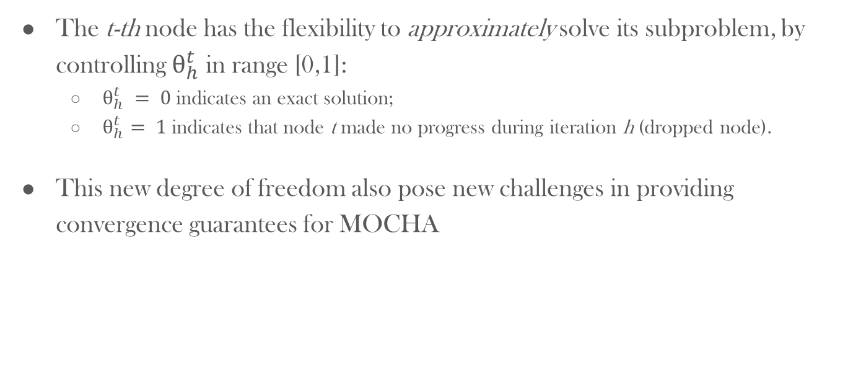
How MOCHA avoids stragglers
The t-th node has the flexibility to approximately solve its subproblem, by controlling $θ_{h}^{t}$ in range [0,1]:
$θ_{h}^{t} = 0$indicates an exact solution;
$θ_{h}^{t}= 1$indicates that node t made no progress during iteration h (dropped node).
This new degree of freedom also pose new challenges in providing convergence guarantees for MOCHA

Slide 14

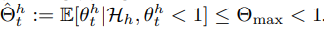

Discussion on assumptions
Convergence guarantees come at a price:
Must assume a non-zero probability of a node sending a result, in any iteration;
The quality of the returned result is, on average, better than the previous iterate.
Having the dual vector history until the beginning of iteration h:

Slide 15
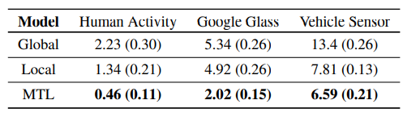
Experiments
Take-away message: for each dataset chosen, multi-task learning significantly outperforms the other models in terms of achieving the lowest average error across tasks.
Average prediction error: Means and standard errors over 10 random shuffles.

Slide 16
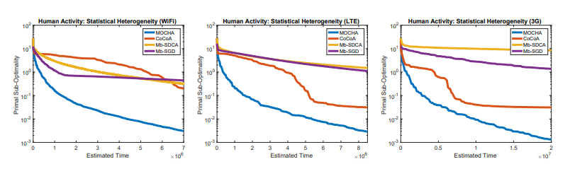
Experiments – 1/3
Statistical Heterogeneity: in high communication regimes, MOCHA and COCOA are robust to high communication. COCOA is significantly affected by stragglers—because θ is fixed across nodes and rounds;
The performance of MOCHA compared to other distributed methods for the W update of (1).

Slide 17
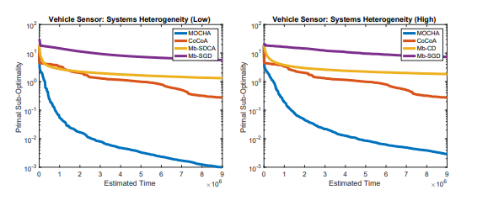
Experiments – 2/3
System Heterogeneity: systems heterogeneity is simulated by randomly choosing the number of local iterations wrt the minimum number of local data points:
between 10% and 100% for high variability;
between 90% and 100% for low variability.

Slide 18
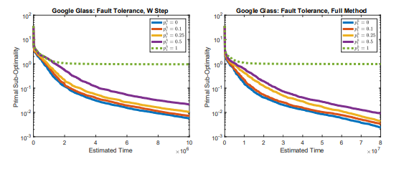
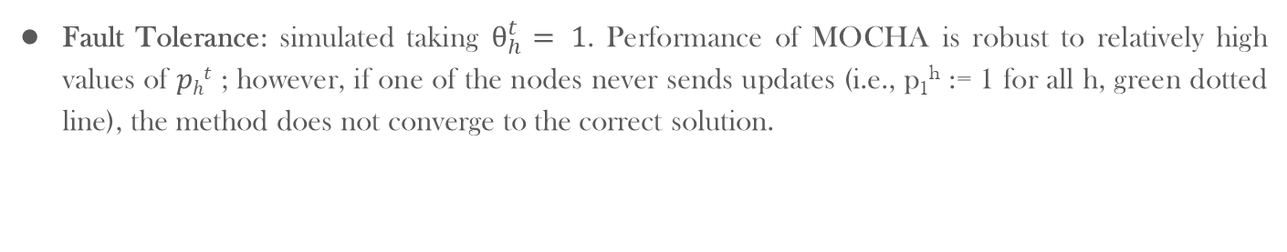
Experiments – 3/3
Fault Tolerance: simulated taking $θ_{h}^{t}= 1$. Performance of MOCHA is robust to relatively high values of $pht$ ; however, if one of the nodes never sends updates (i.e., p₁^{h} := 1 for all h, green dotted line), the method does not converge to the correct solution.

Slide 19
Conclusion
A novel method, MOCHA, that generalizes the distributed optimization method COCOA [22, 31] with convergence guarantees;
MOCHA does not apply to non-convex deep learning models:
Future work can explore this approach and “convexified” deep learning models [6, 34, 51, 56] in the context of kernelized federated multi-task learning;
See Clustered Federated Learning: it is applicable to general non-convex objectives and comes with strong mathematical guarantees on the clustering quality;

Slide 20
Thanks for you attention!

